Slide 1
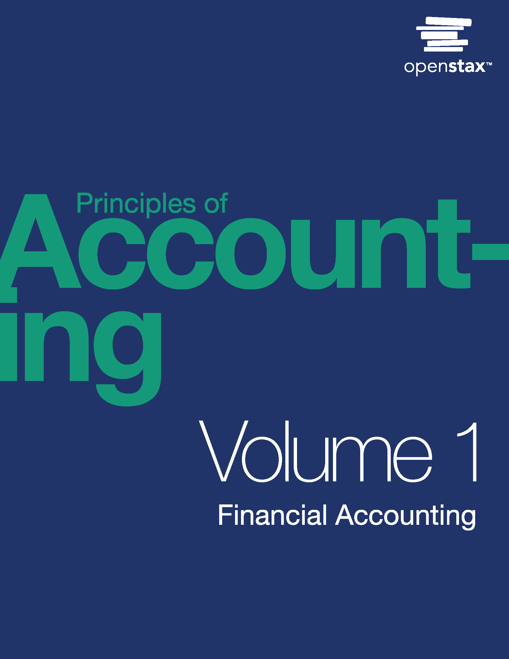
Principles of Accounting, Volume 1: Financial Accounting
Chapter 9 ACCOUNTING FOR RECEIVABLES

Slide 2
Chapter Outline
9.1 Explain the Revenue Recognition Principle and How It Relates to Current and Future Sales and Purchase Transactions
9.2 Account for Uncollectible Accounts Using the Balance Sheet and Income Statement Approaches
9.3 Determine the Efficiency of Receivables Management Using Financial Ratios
9.4 Discuss the Role of Accounting for Receivables in Earnings Management
9.5 Apply Revenue Recognition Principles to Long-Term Projects
9.6 Explain How Notes Receivable and Accounts Receivable Differ
9.7 Appendix: Comprehensive Example of Bad Debt Estimation

Slide 3
Module 9.1 Explain the Revenue Recognition Principle and How It Relates to Current and Future Sales and Purchase Transactions
Revenue recognition principle: states that companies must recognize revenue in the period in which it is earned, i.e., when a four-step process is completed. Remember, this may not necessarily be when cash is collected.
There is credible evidence that an arrangement exists.
Goods have been delivered or services have been performed.
The selling price or fee to the buyer is fixed or can be reasonably determined.
There is reasonable assurance that the amount owed to the seller is collectible.
Accrual accounting also incorporates the matching principle (otherwise known as the expense recognition principle), which instructs companies to record expenses related to revenue generation in the period in which they are incurred.

Slide 4
Sales on Account
Billie’s Watercraft Warehouse (BWW) sells various watercraft vehicles. They extend a credit line to customers purchasing vehicles in bulk. A customer bought 10 Jet Skis on credit at a sales price of $100,000. The cost of the sale to BWW is $70,000.
When the customer pays the amount owed, the following journal entry occurs.

Slide 5
Credit Card Sales
A customer of BWW purchases a canoe for $300, using a Visa credit card. The cost to BWW for the canoe is $150. Visa charges BWW a service fee equal to 5% of the sales price. At the time of sale, the following journal entries are recorded.
When Visa pays the amount owed to BWW, the following entry occurs in BWW’s records.

Slide 6
Alternatively, BWW could record the following at the time of a credit card sale.
Notes:
Teacher Notes: Because credit card sales are “almost the same as cash” since they are guaranteed by the credit card company, some businesses will record credit card transactions as cash rather than as an account receivable.

Slide 7
Sample Exercise
EA2. Prepare journal entries for the following transactions from Cars Plus.
Oct. 18 | Customer Angela Sosa purchased $132,980 worth of car parts with her Standard credit card. The cost to Cars Plus for the sale is $86,250. Standard credit card charges Cars Plus a fee of 4% of the sale.
Oct. 24 | Standard remits payment to Cars Plus, less any fees.

Slide 8
Your Turn: Maine Lobster Market
Maine Lobster Market (MLM) provides fresh seafood products to customers. It allows customers to pay with cash, an in-house credit account, or a credit card. The credit card company charges Maine Lobster Market a 4% fee, based on credit sales using its card. From the following transactions, prepare journal entries for Maine Lobster Market.
Aug. 5 | Pat paid $800 cash for lobster. The cost to MLM was $480.
Aug. 10 | Pat purchased 30 pounds of shrimp at a sales price per pound of $25. The cost to MLM was $18.50 per pound and is charged to Pat’s in-store account.
Aug. 19 | Pat purchased $1,200 of fish with a credit card. The cost to MLM is $865.

Slide 9
Your Turn: Jamal’s Music Supply
Jamal’s Music Supply allows customers to pay with cash or a credit card. The credit card company charges Jamal’s Music Supply a 3% fee, based on credit sales using its card. From the following transactions, prepare journal entries for Jamal’s Music Supply.
May 10 | Kerry paid $1,790 for music supplies with a credit card. The cost to Jamal’s Music Supply was $1,100.
May 19 | Kerry purchased 80 drumstick pairs at a sales price per pair of $14 with a credit card. The cost to Jamal’s Music Supply was $7.30 per pair.
May 28 | Kerry purchased $345 of music supplies with cash. The cost to Jamal’s Music Supply was $122.

Slide 10
Module 9.2 Account for Uncollectible Accounts Using the Balance Sheet and Income Statement Approaches
Bad debts are uncollectible amounts from customer accounts and are a necessary aspect of allowing customers to use credit to pay for goods and services.
Bad debt negatively affects accounts receivable.
When future collection of receivables cannot be reasonably assumed, companies must estimate the amount of expected nonpayment.
Methods a company may use to recognize bad debt:
The direct write-off method
The allowance method
Aging of accounts receivable method
Notes:
Teacher Notes: Ask students why companies are willing to extend credit to customers even though they know some customers may not pay.

Slide 11
Direct Write-off Method
A bad debt is written off when the company is fairly certain that collection is not possible.
This method is not acceptable under GAAP because it violates the matching principle.
For example, a sale that occurs in January is not written off until November.
January’s income includes the sale.
November’s income includes bad debt expense.
Notes:
Teacher Notes: An exception to using the direct write-off method is if the results would not be substantially different than the company would get if they used the allowance method. Thus, a company that has very few credit sales could use the direct write-off method.

Slide 12
Allowance Method
The allowance method estimates bad debt during a period, based on past experience and industry standards.
Matches bad debt with related sales during the period
Two approaches to calculate amount of bad debt expense:
Income statement approach
Balance sheet approach
Journal entry the same under either approach
Notes:
Teacher Notes: An exception to using the direct write-off method is if the results would not be substantially different than the company would get if it used the allowance method. Thus, a company that has very few credit sales could use the direct write-off method.

Slide 13
The allowance for doubtful accounts is a contra asset account and is subtracted from Accounts Receivable.
A contra account has an opposite normal balance to its paired account.
The adjustment can be an addition or a subtraction from a controlling account.
Net Realizable Value of Accounts Receivable appears on the balance sheet and is gross Accounts Receivable minus allowance for doubtful accounts on the balance sheet.
Notes:
Teacher Notes: An exception to using the direct write-off method is if the results would not be substantially different than the company would get if it used the allowance method. Thus, a company that has very few credit sales could use the direct write-off method.

Slide 14
Assume a company has reported an Accounts Receivable balance of $90,000 and a Balance in the Allowance of Doubtful Accounts of $4,800. The following shows how this information would be reported in the current (short-term) section of the company’s Balance Sheet.
Gross Accounts Receivable
Contra Account
Net Accounts Receivable
Modified for PPT.
Notes:
Teacher Notes: The $85,200 total is the net realizable value, or the amount of accounts anticipated to be collected. However, the company is owed $90,000 and will still try to collect the entire $90,000 and not just the $85,200.

Slide 15
If the company already had a credit balance in Allowance for Doubtful Accounts from the prior period of $1,000 and a current period estimated balance of $2,500, the company would need to subtract the prior period’s credit balance from the current period’s estimated credit balance in order to calculate the amount to be added to the Allowance for Doubtful Accounts.
Therefore, the adjusting journal entry would be as follows.
Notes:
Teacher Notes: As the amount of accounts receivables changes, the estimated uncollectible accounts will change as well.

Slide 16
If instead the company already had a debit balance from the prior period of $1,000, and a current period estimated balance of $2,500, the company would need to add the prior period’s debit balance to the current period’s estimated credit balance.
Therefore, the adjusting journal entry would be as follows.

Slide 17
When a specific customer has been identified as an uncollectible account, the following journal entry would occur.
Let’s say that the customer unexpectedly pays on the account in the future.
Notes:
Teacher Notes: Allowance for Doubtful Accounts decreases (debit) and Accounts Receivable for the specific customer also decreases (credit). Allowance for doubtful accounts decreases because the bad debt amount is no longer unclear. Accounts receivable decreases because there is an assumption that no debt will be collected on the identified customer’s account. The first entry reverses the previous entry where bad debt was written off. This reinstatement requires Accounts Receivable: Customer to increase (debit), and Allowance for Doubtful Accounts to increase (credit). The second entry records the payment on the account. Cash increases (debit) and Accounts Receivable: Customer decreases (credit) for the amount received.

Slide 18
Think It Through: Bad Debt Estimation
As the accountant for a large publicly traded food company, you are considering whether or not you need to change your bad debt estimation method. You currently use the income statement method to estimate bad debt at 4.5% of credit sales. You are considering switching to the balance sheet aging of receivables method. This would split accounts receivable into three past- due categories and assign a percentage to each group.
While you know that the balance sheet aging of receivables method is more accurate, it does require more company resources (e.g., time and money) that are currently applied elsewhere in the business. Using the income statement method is acceptable under generally accepted accounting principles (GAAP), but should you switch to the more accurate method even if your resources are constrained? Do you have a responsibility to the public to change methods if you know one is a better estimation?

Slide 19
Income Statement Method
The income statement method (also known as the percentage of sales method) estimates bad debt expenses based on the assumption that at the end of the period, a certain percentage of sales during the period will not be collected. The estimation is typically based on credit sales only, not total sales.

Slide 20
Let’s continue with Billie’s Watercraft Warehouse (BWW) as the example. Billie’s end-of-year credit sales totaled $458,230. BWW estimates that 5% of its overall credit sales will result in bad debt. The following adjusting journal entry for bad debt occurs.
$458,230 × 5%
Modified for PPT.

Slide 21
On April 8, it was determined that Customer Robert Craft’s account was uncollectible in the amount of $5,000. BWW makes the following entry:

Slide 22
On June 5, Craft unexpectedly makes a partial payment on his account in the amount of $3,000.

Slide 23
Your Turn: Heating and Air Company
You run a successful heating and air conditioning company. Your net credit sales, accounts receivable, and allowance for doubtful accounts figures for year-end 2018, follow.
Compute bad debt estimation using the income statement method, where the percentage uncollectible is 5%.
Prepare the journal entry for the income statement method of bad debt estimation.
Compute bad debt estimation using the balance sheet method of percentage of receivables, where the percentage uncollectible is 9%.
Prepare the journal entry for the balance sheet method bad debt estimation.

Slide 24
Balance Sheet Method
The balance sheet method (also known as the percentage of accounts receivable method) estimates bad debt expenses based on the balance in accounts receivable. The method looks at the balance of accounts receivable at the end of the period and assumes that a certain amount will not be collected.

Slide 25
Assume that BWW’s end-of-year accounts receivable balance totaled $324,850. This entry assumes a zero balance in Allowance for Doubtful Accounts from the prior period. BWW estimates 15% of its overall accounts receivable will result in bad debt. BWW would record the following.
Prior Period Allowance Balance $ 0.00
Current Period Estimated 48,727.50
Allowance for Doubtful Accounts $48,727.50

Slide 26
What if instead, BWW had a $23,000 credit balance in the allowance for doubtful accounts from the previous period. The adjusting entry would be as follows.
Notes:
Teacher Notes: The balance in the allowance for doubtful accounts should represent the part of the total accounts receivable that the company feels may be uncollectible. Some of those sales occurred this period, and some occurred in the prior period.

Slide 27
The balance sheet aging of receivables method estimates bad debt expenses based on the balance in accounts receivable, but it also considers the uncollectible time period for each account. The longer the time passes with a receivable unpaid, the lower the probability that it will get collected
For BWW, it has an accounts receivable balance of $324,850 at the end of the year. The company splits its past-due accounts into three categories: 0–30 days past due, 31–90 days past due, and over 90 days past due. The uncollectible percentages and the accounts receivable breakdown are shown here.

Slide 28
The journal entry to record the estimation of bad debts using aging of accounts receivable would be as follows.

Slide 29
Suppose BWW had a $20,000 debit balance in Allowance for Doubtful Accounts from the previous period. The adjusting journal entry would recognize the following.

Slide 30
Sample Exercise
EA13. Dortmund Stockyard reports $896,000 in credit sales for 2018 and $802,670 in 2019. It has a $675,000 accounts receivable balance at the end of 2018, and $682,000 at the end of 2019. Dortmund uses the balance sheet method to record bad debt estimation at 8% during 2018. To manage earnings more favorably, Dortmund changes bad debt estimation to the income statement method at 6% during 2019.
Determine the bad debt estimation for 2018.
Determine the bad debt estimation for 2019.
Describe a benefit to Dortmund Stockyard in 2019 as a result of its earnings management.

Slide 31
Module 9.3 Determine the Efficiency of Receivables Management Using Financial Ratios
Stakeholders, such as investors, lenders, and management, use financial statement data to make informed decisions about a company’s financial position.
They will look at each statement—as well as ratio analysis—for trends, industry comparisons, and past performance to help make financing determinations.

Slide 32
Accounts receivable turnover ratio: determines how many times (i.e., how often) accounts receivable are collected during an operating period and converted to cash
Number of days’ sales in receivables ratio: is similar to accounts receivable turnover in that it shows the expected days it will take to convert accounts receivable into cash. The reflected outcome is in number of days, rather than in number of times.

Slide 33
Computing Accounts Receivable Turnover

Slide 34
Computing Days in Accounts Receivable

Slide 35
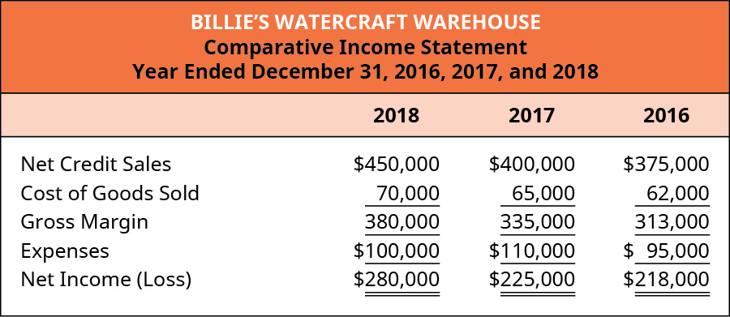
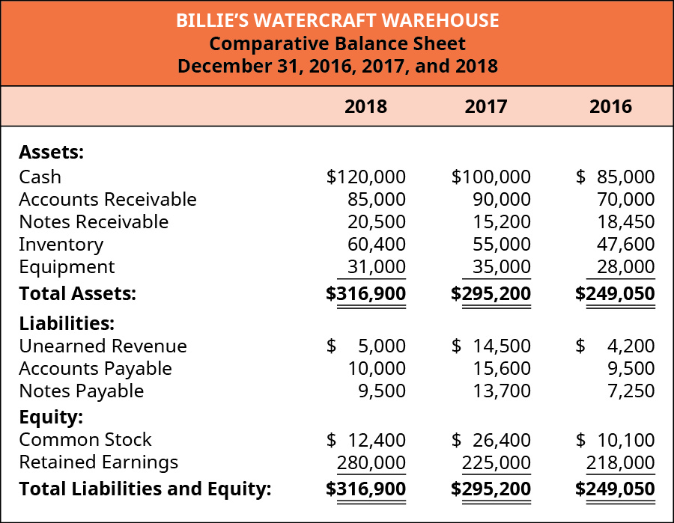
Figure 9.4 and Figure 9.5
Let’s use Billie’s Watercraft Warehouse (BWW) as the example. Included are the comparative income statement and the comparative balance sheet for BWW, for the years 2016, 2017, and 2018.
Comparative Income Statements for Billie’s Watercraft Warehouse for the Years 2016, 2017, and 2018. (attribution: Copyright Rice University, OpenStax, under CC BY-NC-SA 4.0 license)
Comparative Income Statements for Billie’s Watercraft Warehouse for the Years 2016, 2017, and 2018. (attribution: Copyright Rice University, OpenStax, under CC BY-NC-SA 4.0 license)

Slide 36
Compute the Accounts Receivable Turnover for BWW for 2017 and 2018
Net credit sales for 2017 are $400,000, and average accounts receivable = ($70,000 + $90,000)/2 = $80,000
Accounts receivable turnover ratio for 2017 is 5 × ($400,000/$80,000) = 5.14 times
Net credit sales for 2018 are $450,000, and average accounts receivable = ($90,000 + $85,000)/2 = $87,500
Accounts receivable turnover ratio for 2018 is 5 × ($450,000/$87,500) = 5 times

Slide 37
Compute the Days in Accounts Receivable for BWW for 2017 and 2018
The ratio for 2017 is 73 days (365/5).
The ratio for 2018 is 71.01 days (365/5.14).

Slide 38
Interpreting BWW’s Ratio Results
Year | Accounts Receivable Turnover | Days in Receivables Ratio
2017
BWW | 5.14 times | 73 days
Competitor | 4.92 times | 79.23 days
2018
BWW | 5 times | 71.01 days
Competitor | 5.25 times | 76.44 days
Notes:
Teacher Notes: From 2017 to 2018, there was a slight decrease in the AR turnover for BWW, and this may or may not be significant enough for management to look into the cause. However, from 2017 to 2018, BWW did improve in its collections and collected the amounts owed to it almost two days sooner than in 2017. Comparing with oneself is important, but it is also important to compare to the industry or competitors. In 2017, BWW had a better AR Turnover than the competitor but not in 2018. BWW is better at collecting what is owed to it than the competitor in both years.

Slide 39
Sample Problem
PA8. The following select financial statement information from Candid Photography.
Compute the accounts receivable turnover ratios and the number of days’ sales in receivables ratios for 2018 and 2019 (round answers to two decimal places). What do the outcomes tell a potential investor about Candid Photography if industry average for accounts receivable turnover ratio is 3 times and days’ sales in receivables ratio is 150 days?

Slide 40
Module 9.4 Discuss the Role of Accounting for Receivables in Earnings Management
Earnings management works within GAAP constraints to improve stakeholders’ views of the company’s financial position.
Earnings manipulation is noticeably different in that it typically ignores GAAP rules to alter earnings significantly. Carried to an extreme, manipulation can lead to fraudulent behavior by a company.
Notes:
Teacher Notes: A company may be enticed to manipulate earnings for several reasons. It may want to show a healthier income level, meet or exceed market expectations, and receive management bonuses. This can produce more investment interest from potential investors. An increase to receivables and inventory can help a business to secure more borrowed funds.

Slide 41
Billie’s Watercraft Warehouse (BWW) had the following net credit sales and accounts receivable from 2016–2018.
BWW also used the following percentage calculations for doubtful accounts under each bad debt estimation method.
Notes:
Teacher Notes: Legitimate current economic conditions could allow BWW to alter its estimation percentages, aging categories, and method used.

Slide 42
What are the effects of BWW changing either of its estimation percentages?
A decease of the income statement method percentage from 5% of credit sales to 4% of credit sales
Bad debt estimation would go from $22,500 (5% × $450,000) in 2018 to $18,000 (4% × $450,000)
Bad debt expense would decrease for the period, and net income would increase.
A decrease of the balance sheet method percentage from 15% of accounts receivable to 12% of accounts receivable
Bad debt estimation would go from $12,750 (15% × $85,000) in 2018 to $10,200 (12% × $85,000)
Bad debt expense would decrease for the period and net income would increase.
Notes:
Teacher Notes: Again, legitimate current economic conditions could allow BWW to alter its estimation percentages, aging categories, and method used. The opposite of these percentage changes could occur as well. Imagine that most of BWW’s customers are local and that a major employer shut down, meaning many of BWW’s customers are more likely to have difficulty paying, and BWW may need to raise its bad debt estimation percentage regardless of the application/estimation method being used.

Slide 43
Suppose the following is the original uncollectible distribution for BWW in 2018.
BWW changes its estimation percentages for each category. Look at the change in estimated uncollectible receivables.

Slide 44
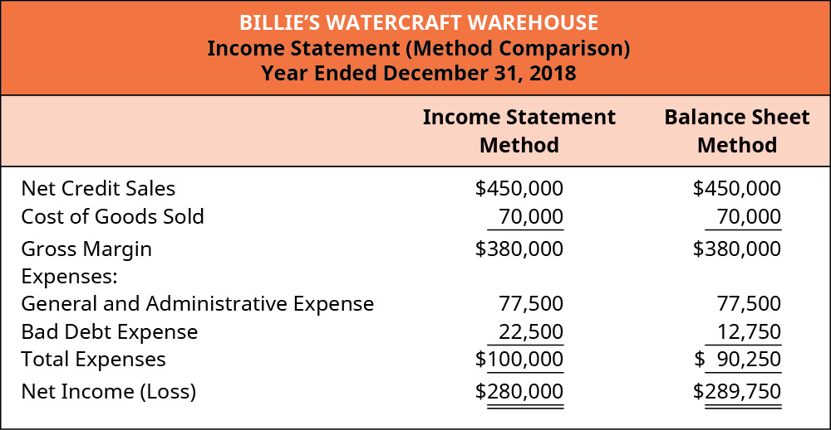
Suppose BWW decided to change from the income statement method to the balance sheet method for estimating bad debts. What is the effect on net income?
Notes:
Teacher Notes: A company cannot change methods simply to make income appear better, but the company could change methods, if the method provides a better match with its actual situation. The change would have to be considered to reflect the company’s actual bad debt experiences accurately, and not just made for the sake of manipulating the income and expenses reported on its financial statements.

Slide 45
Your Turn: The Investor
You are an investor looking to contribute financially to either Company A or Company B. The following select financial information follows.
Based on the information provided:
Compute the accounts receivable turnover ratio
Compute the number of days’ sales in receivables ratio for both Company A and Company B (round all answers to two decimal places)
Interpret the outcomes, stating which company you would invest in and why

Slide 46
Module 9.5 Apply Revenue Recognition Principles to Long-Term Projects
In some types of sales and service transactions, revenue recognition and expense recognition are less clear cut. Examples include the following:
Long-term construction-company projects
Real estate installment sales
Multi-year magazine subscriptions
A combined equipment sale with an accompanying service contract
These types of transactions have special reporting requirements to meet revenue recognition and matching principles.

Slide 47
Long-term construction-company projects
Percentage of completion: recognizes revenue based on the percentage of the work that has been done
Completed contract: recognizes all revenue at the time the project is completed
Real estate installment sales
Recognizes revenue using the gross profit percentage each time the buyer makes a payment to the seller.
Multi-year magazine subscriptions
These are typically paid for in advance, and revenue is recognized as the service is performed.
A combined equipment sale with an accompanying service contract
The sale portion of the contract is recognized immediately, but the revenue allocated to the service portion is recognized over the service period.
Notes:
Teacher Notes: Percentage of completion—the assumption is that if 40 percent of the work has been done, then 40 percent of the costs have been incurred, so 40 percent of the revenue can be recognized. Completed contract—improper matching because costs are being recognized as incurred, but revenues are only recognized at the end of the project, even if that is years later.
The installment method accounts for risk and defers revenue using a gross profit percentage. These types of plans are typically for commercial real estate and have the effect of deferring revenue until collections (installments) are received.
Subscriptions, of any sort, would use this method; other examples include gym memberships and airline tickets.
Cell phones with service contracts are an example of equipment sale with accompanying service contract.

Slide 48
Module 9.6 Explain How Notes Receivable and Accounts Receivable Differ
Notes receivable has several defining characteristics:
Principal of a note is the initial loan amount, not including interest.
Issue date is the date on which the security agreement is initially established.
Maturity date is the date at which the principal and interest become due and payable.
The maturity date is established in the initial note contract.
Interest is a monetary incentive to the lender that justifies loan risk.
Interest rate is the part of a loan charged to the borrower, expressed as an annual percentage of the outstanding loan amount.

Slide 49
Key Feature Comparison of Accounts Receivable and Notes Receivable
Table 9.2
Accounts Receivable | Notes Receivable
An informal agreement between customer and company Receivable in less than one year or within a company’s operating cycle Does not include interest | A legal contract with established payment terms Receivable beyond one year and outside of a company’s operating cycle Includes interest

Slide 50
A customer buys goods from Acme Co. for $2,000 and signs a note to repay the amount in 24 months, at 10%.
Suppose, instead, that the customer borrowed cash of $2,000 and signs a note to repay the amount in 24 months, at 10%.
Modified for PPT.

Slide 51
Each period the company needs to record an entry for accumulated interest during the period.
10% × $2,000 × (12/12) = $200
Another common way to express interest is Principle × Rate × Time
$2,000 × 10% × 12/12
The $200 is recognized in Interest Revenue and Interest Receivable.
Notes:
Teacher Notes: The lender (company) has “earned” the interest but has not received it yet because it (the cash) is not legally due. The financial statements need to accurately reflect that this money is owed to the company but that there is not a legal obligation for it to be paid on the current date.

Slide 52
On the due date, the company would record the receipt of the cash for both the principle, and the interest and the interest revenue for the current year.
Theses entries could be combined into one entry.
Notes:
Teacher Notes: The note spanned two years, so one-half of the interest revenue belonged to last year and one-half to the current year.

Slide 53
If the customer does not pay within the specified contract length, the note is considered a dishonored note. A lender will still pursue collection of the note but will not maintain a long-term receivable on its books. Instead, the lender will convert the notes receivable and interest due into an account receivable.

Slide 54
Sample Exercise
EA5. Millennium Associates records bad debt using the allowance, income statement method. They recorded $299,420 in accounts receivable for the year, and $773,270 in credit sales. The uncollectible percentage is 3.2%. On February 5, Millennium Associates identifies one uncollectible account from Molar Corp in the amount of $1,330. On April 15, Molar Corp unexpectedly pays its account in full. Record journal entries for the following.
Year-end adjusting entry for 2017 bad debt
February 5, 2018 identification entry
Entry for payment on April 15, 2018

Slide 55
Converting an Account Receivable to a Note Receivable
This may occur if a customer has missed payments and the company extends the due date but adds interest.
For example, a company may have an outstanding account receivable in the amount of $1,000. The customer negotiates with the company on June 1 for a six-month note maturity date, 12% annual interest rate, and $250 cash up front.

Slide 56
A company may consider selling a receivable to a collection agency.
The collection agency pays the company a fraction of the note’s value.
The company would write off any difference as a factoring (third-party debt collection) expense.
Let’s say that our example company turned over the $2,200 accounts receivable to a collection agency on March 5, 2019 and received only $500 for its value. The difference between $2,200 and $500 of $1,700 is the factoring expense.

Slide 57
Think It Through: Dishonored Note
You are the owner of a retail health food store and have several large companies with whom you do business. Many competitors in your industry are vying for your customers’ business. For each sale, you issue a notes receivable to the company, with an interest rate of 10% and a maturity date 18 months after the issue date. Each note has a minimum principal amount of $500,000.
Let’s say one of these companies is unable to pay in the established timeframe and dishonors the note. What would you do? How does this dishonored note affect your company both financially and nonfinancially? If your customer wanted to renegotiate the terms of the agreement, would you agree? If so, what would be the terms?

Slide 58
Module 9.7 Appendix: Comprehensive Example of Bad Debt Estimation
Furniture Direct sells office furniture to large scale businesses.
They allow customers to pay on credit using an in-house account.
At the end of the year, Furniture Direct must estimate bad debt using one of the three estimation methods.
It is currently using the income statement method and estimates bad debt at 5% of credit sales.
If it were to switch to the balance sheet method, it would estimate bad debt at 8% of accounts receivable.
If it were to use the balance sheet aging of receivables method, it would split its receivables into three categories: 0–30 days past due at 5%, 31–90 days past due at 10%, and over 90 days past due at 20%.
There is currently a zero balance, transferred from the prior year’s Allowance for Doubtful Accounts.
The following information is available from the year-end income statement and balance sheet.

Slide 60
If the company were to maintain the income statement method, the total bad debt estimation would be $67,500 ($1,350,000 × 5%), and the following adjusting entry would occur.

Slide 61
If the company were to use the balance sheet method, the total bad debt estimation would be $59,600 ($745,000 × 8%), and the following adjusting entry would occur.

Slide 62
If the company were to use the balance sheet aging of receivables method, the total bad debt estimation would be $58,250, calculated as shown.
The adjusting entry recorded using the aging method is as follows.

Slide 63
$745,000 in Accounts Receivable, but different level of Bad Debt Expense based on the estimation method
Notes:
Teacher Notes: Any of these methods are acceptable and appropriate, but it is obvious that they each result in different bad debt estimates.

Slide 64
Sample Exercise
EA15. Resin Milling issued a $390,500 note on January 1, 2018 to a customer in exchange for merchandise. The merchandise had a cost to Resin Milling of $170,000. The terms of the note are 24-month maturity date on December 31, 2019 at a 5% annual interest rate. The customer does not pay on its account and dishonors the note. Record the journal entries for Resin Milling for the following transactions.
Initial sale on January 1, 2018
Dishonored note entry on January 1, 2020, assuming interest has not been recognized before note maturity

Slide 65
Summary
According to the revenue recognition principle, a company will recognize revenue when a product or service is provided to a client. The revenue must be reported in the period when the earnings process completes.
According to the matching principle, expenses must be matched with revenues in the period in which they are incurred. A mismatch in revenues and expenses can lead to financial statement misreporting.
When a customer pays for a product or service on a line of credit, the Accounts Receivable account is used. Accounts receivable must satisfy the following criteria: the customer owes money and has yet to pay, the amount is due in less than a company’s operating cycle, and the account usually does not incur interest.
Bad debt is a result of unpaid and uncollectible customer accounts. Companies are required to record bad debt on financial statements as expenses.
The direct write-off method records bad debt only when the due date has passed for a known amount. Bad Debt Expense increases (debit) and Accounts Receivable decreases (credit) for the amount uncollectible.
The income statement method estimates bad debt based on a percentage of credit sales. Bad Debt Expense increases (debit) and Allowance for Doubtful Accounts increases (credit) for the amount estimated as uncollectible.
The balance sheet method estimates bad debt based on a percentage of outstanding accounts receivable. Bad Debt Expense increases (debit) and Allowance for Doubtful Accounts increases (credit) for the amount estimated as uncollectible.
The balance sheet aging of receivables method estimates bad debt based on outstanding accounts receivable, but it considers the time period that an account is past due. Bad Debt Expense increases (debit) and Allowance for Doubtful Accounts increases (credit) for the amount estimated as uncollectible.

Slide 66
Summary (continued)
The accounts receivable turnover ratio shows how many times receivables are collected during a period and converted to cash. The ratio is found by taking net credit sales and dividing by average accounts receivable for the period.
The number of days’ sales in receivables ratio shows the expected number of days it will take to convert accounts receivable into cash. The ratio is found by taking 365 days and dividing by the accounts receivable turnover ratio.
Earnings management can occur in several ways, including changes to bad debt estimation methods, percentage uncollectible figures, and category distribution within the balance sheet aging method.
Some revenue transactions cannot be recognized instantly examples include Long-term construction projects, Real estate installment sales, multi-year magazine subscriptions, and a combined equipment purchase with accompanying service contract.
Accounts receivable is an informal agreement between customer and company, with collection occurring in less than a year, and no interest requirement. In contrast, notes receivable is a legal contract, with collection occurring typically over a year, and interest requirements.
The terms of a note contract establish the principal collection amount, maturity date, and annual interest rate.
Interest is computed as the principal amount multiplied by the part of the year, multiplied by the annual interest rate. The entry to record accumulated interest increases interest receivable and interest revenue.

Slide 67
This OpenStax ancillary resource is © Rice University under a CC-BY-NC-SA 4.0 International license; it may be reproduced or modified for noncommercial purposes only but must be attributed to OpenStax, Rice University and any changes must be noted. Any adaptation must be shared under the same type of license.

